Slide 1
LGBTQIA+ 101
Kat Newman (she/her/hers)
Amherst CRESS Department

Slide 2
Workshop Overview
Introduction (2 mins)
Workshop Guidelines (2 mins)
Cycle of Socialization, Current Events (10 mins)
Video: LGBTQIA+ Acronym, Terms, and Concepts Overview(10 mins)
Expanding Knowledge of Gender (30 mins)
Terminology (5 mins)
Pronoun 101 + Gender Neutral Language Practice (10 mins)
Scenarios (10 mins)
Jeopardy (5 min)
Notes:
CRESS Implementation Manager
Former LGBTQ Program Specialist
Created LGBTQ Liasion Positions in workplace settings
Trained intergroup dialogue facilitator (IGD) with focus on race and gender

Slide 3
Workshop Guidelines
Recognize your communication style
Expect to learn something new about yourself and others
Speak from your own experience & avoid generalizations
Participate honestly & openly and/or pass
Explore your own emotional reactions, perceptions, and assumptions
Commit to confidentiality and curiosity
Take responsibility for what you say

Slide 4
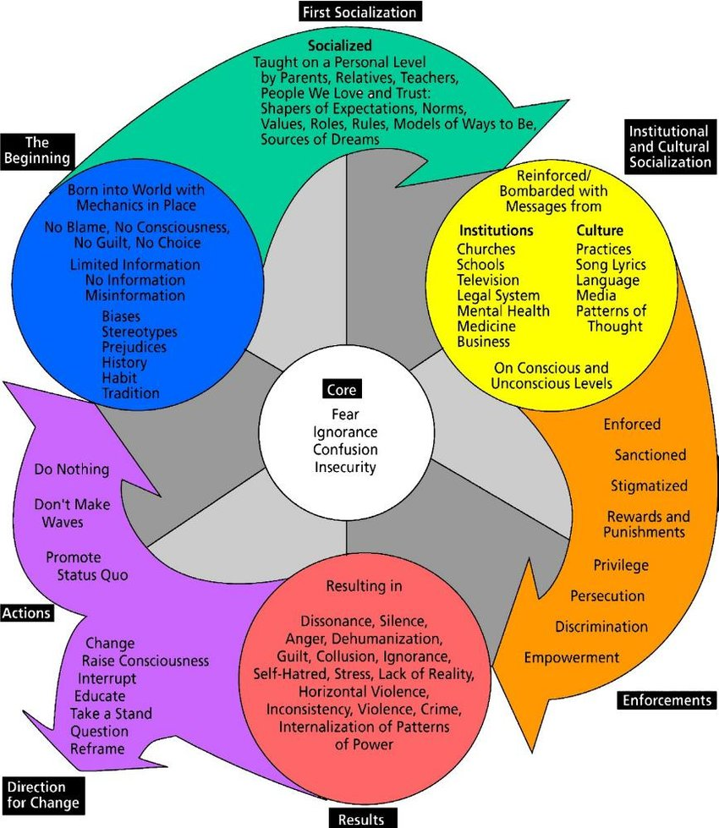
Cycle of Socialization
Pair and share:
What is the first experience you remember about becoming aware of your gender?
Please share a time where received messaging that you were operating outside of the expectations or roles of your “gender”?

Slide 5
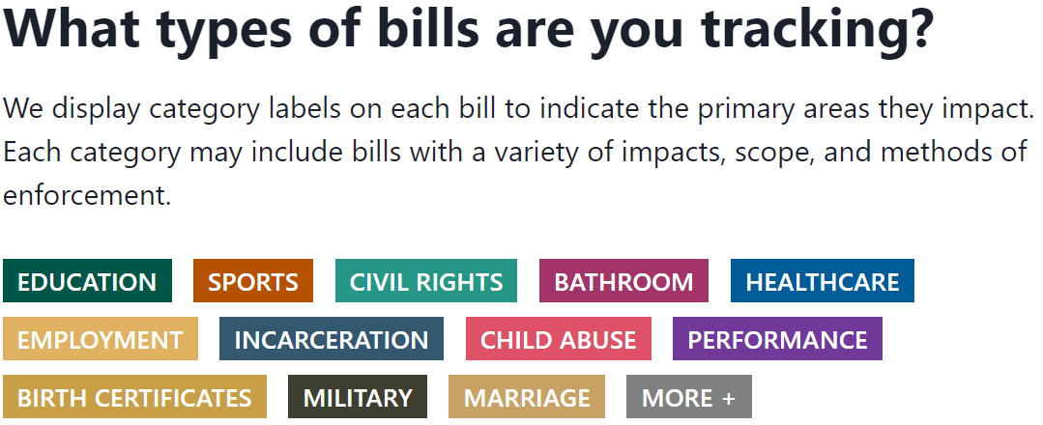
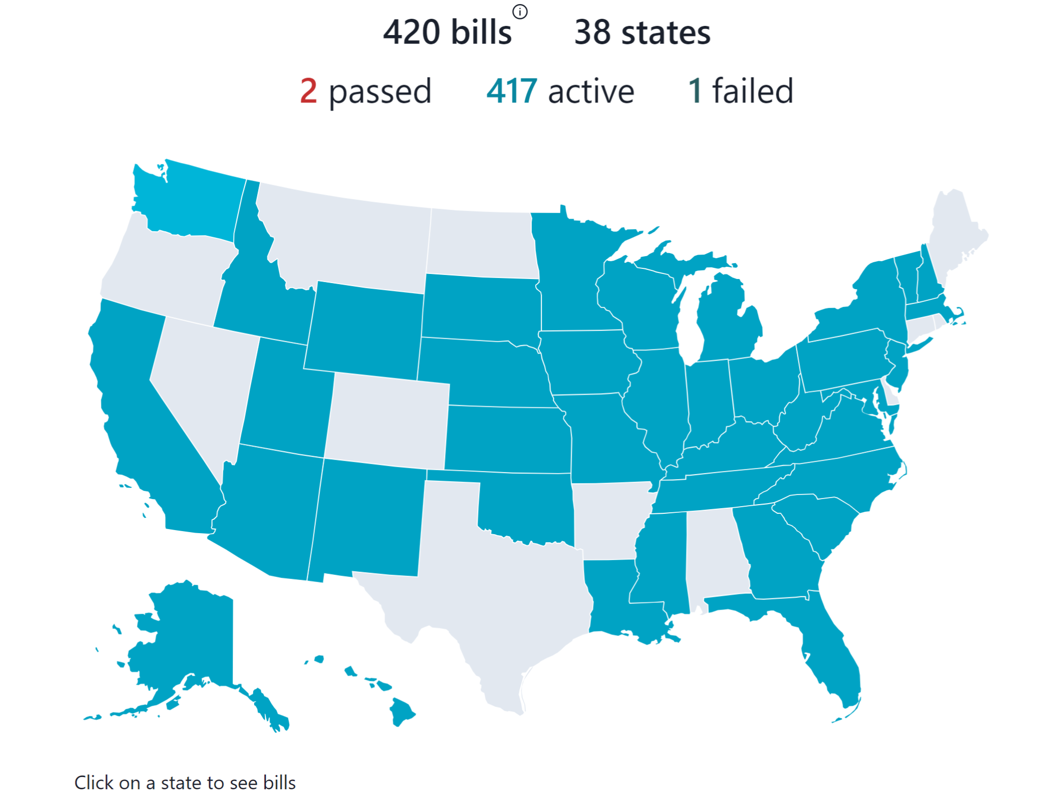
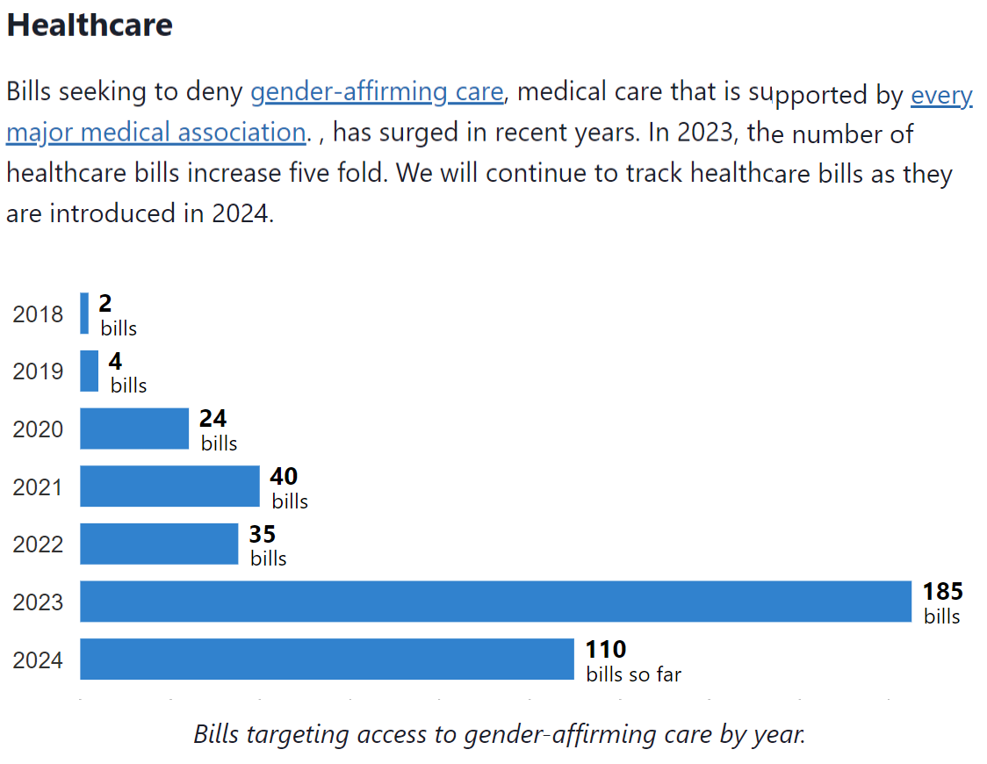
Current Events
2024 anti-trans bills tracker
https://translegislation.com/

Slide 6
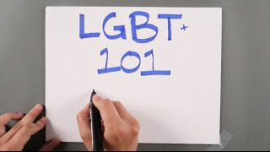
LGBTQQIAA+ Overview
Four Main Traits/Concepts:
Gender Identity
Sexual Orientation
Biological Sex
Gender Expression

Slide 7
Terminology
Match the term to the corresponding definition

Slide 8
Pronouns: Linguistic Tools that we use to Refer to People
Pronouns can be an indicator of gender identity, but not always.
We should not assume someone’s gender identity based on the pronouns they choose to use or how they express themselves.
By allowing someone to share their pronouns with you, you are not assuming a person’s gender identity.
Practice is key to becoming comfortable using the correct pronouns.
When you mess up (it happens!), apologize and move on (don’t dwell)

Slide 9
Learning Check: fill in the blank
Example: they go to the store. I bought them a soda. That’s their soda.
Sandy (they/them/theirs):
bought a book. put it on the desk. This is favorite book.
Johnny (they/them/theirs):
Have you seen ? I last saw down the hallway when were looking for backpack.
Marissa (they/them/theirs; she/her/hers):
is meeting me to go shopping. I am going to pick up, even though suggested we drive car.

Slide 10
Gender Neutral Language
Activity primer questions (large group):
Someone walks up to the front window and asks to use the restroom. How do you greet them and what do you tell them?
Someone’s identification does not match the name they just stated to you. How do you respond?
A coworker starts using new pronouns. You overhear people mispronouning them. What do you do?
Gender Neutral Language Practice (pairs)
Complete the “Using Gender Neutral Language” worksheet

Slide 11
Scenario-Based Practice
Spend a few minutes discussing the various answers to your assigned scenario

Slide 12
Jeopardy

Slide 13
Questions?
Kat Newman
newmank@amherstma.gov
413-259-3348

